Slide 1
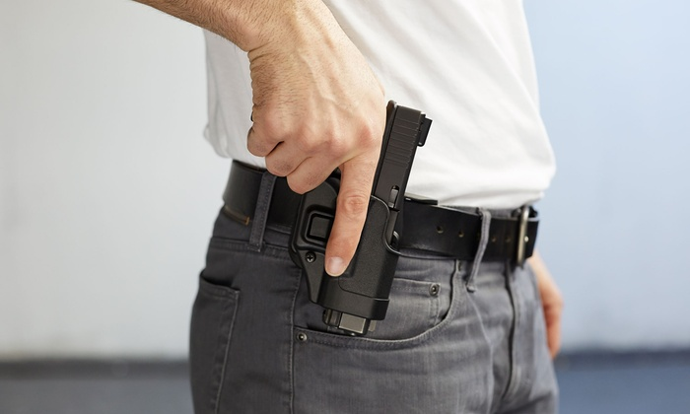
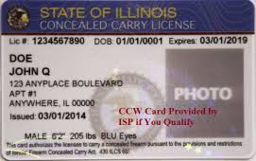
Register Now Illinois Concealed Carry 3 Hour Renewal $40.00

