Slide 1
Fearless Financials: Conquering the Worries of Managing Money for Small Business Owners
Presented by:
KU Small Business Development Center
and
Data Scribe Solutions
Brought to you by the:
Ottawa Chamber of Commerce
Notes:
Carrie

Slide 2
KU Small Business Development Center
Advising. Consulting. Training. Growing Entrepreneurs
Notes:
Carrie

Slide 3
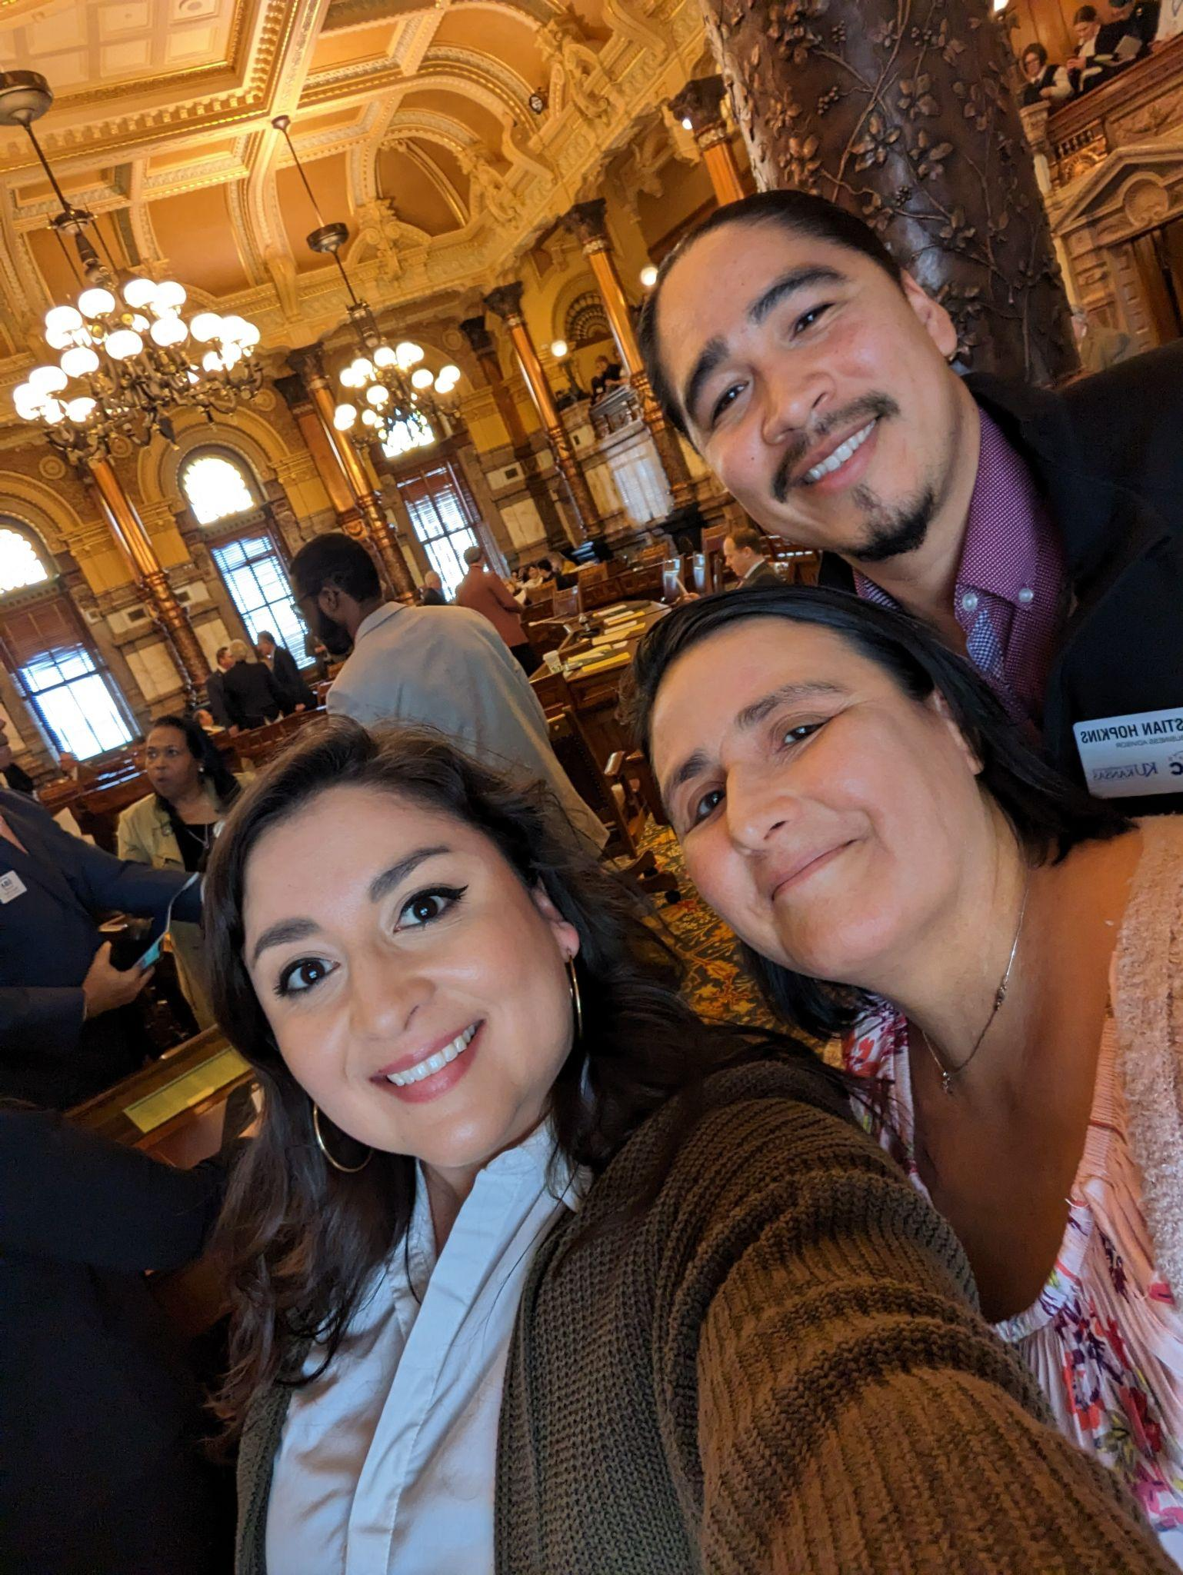
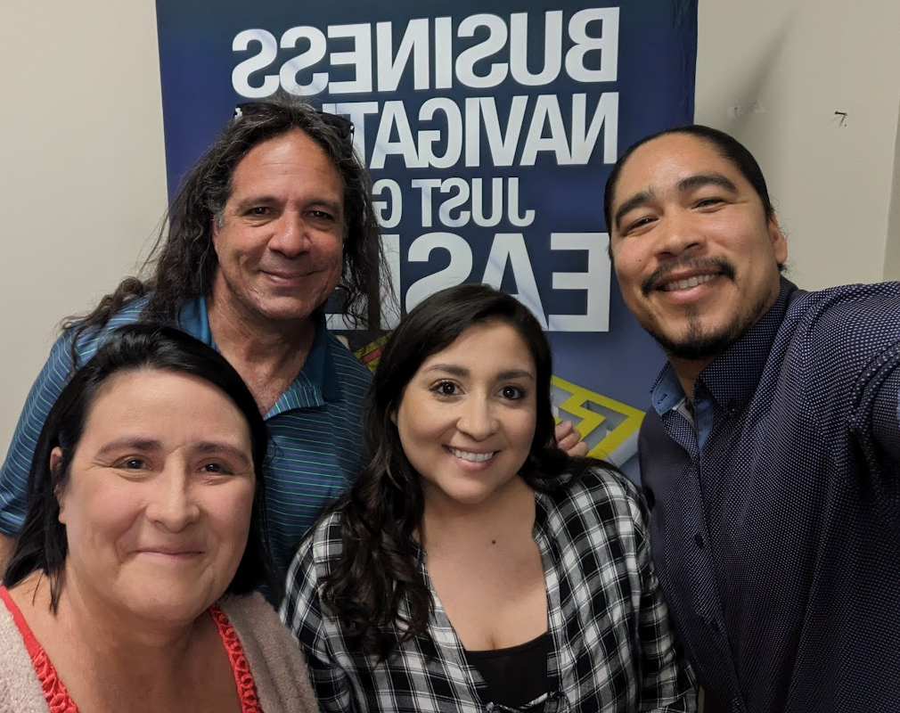
OUR TEAM
Kristina Edwards,
Regional Director
Carrie Poe,
Business Advisor
Christian Hopkins, Business Advisor
Will Katz,
Business Advisor
Notes:
Carrie

Slide 4
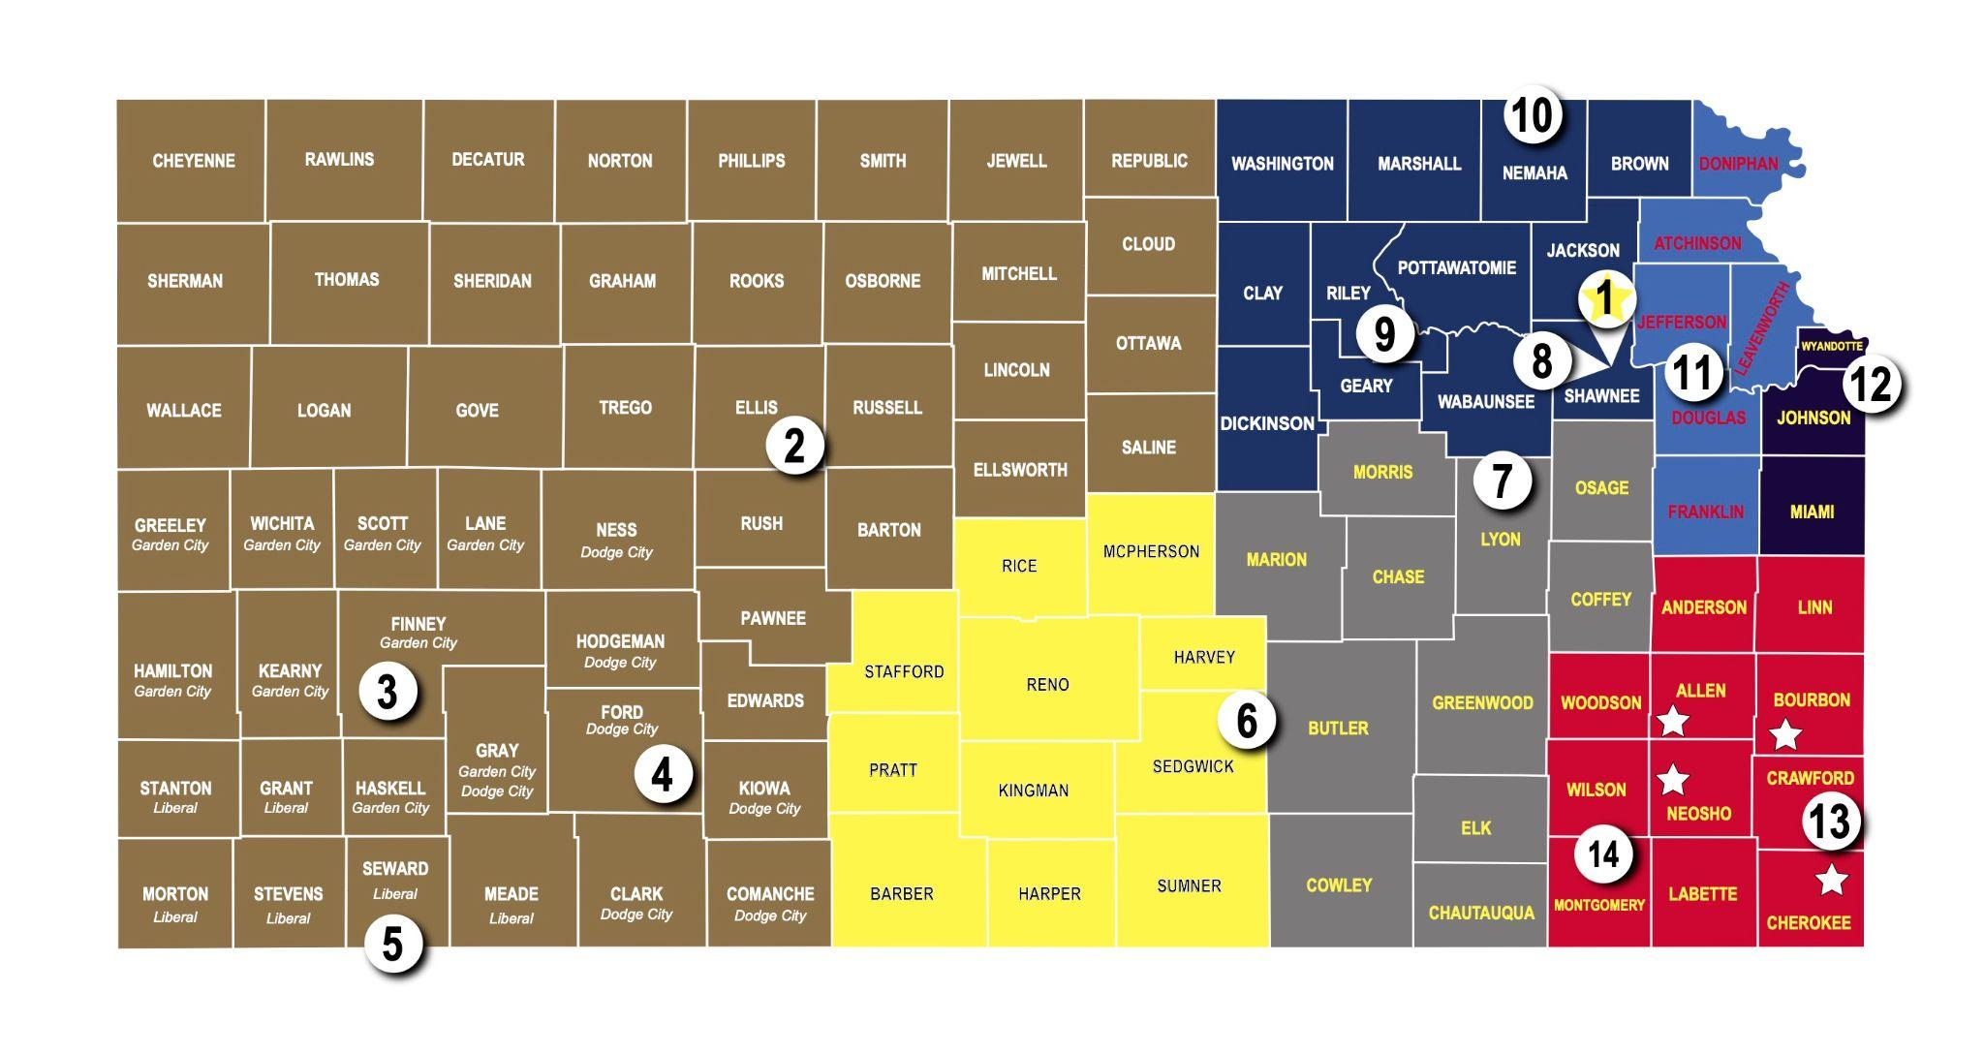
Kansas Small Business Development Centers
KU SBDC covers 6 counties
~ 1,100 Centers across the US
Fun Fact: The KU SBDC office is near downtown Lawrence (not on campus)
Notes:
Carrie

Slide 5
Our Mission
Our Vision
Help more people!
Mission:
Help More People
Vision:
One small business at a time
Grow Kansas one small business at a time.
Notes:
Carrie

Slide 6
What We Do
Individual, one-to-one FREE and confidential advising for start-up AND existing businesses
Focused trainings + content providers
University classes and events
Chambers
and more
Connect to appropriate resources
Community Partnerships (YEC, Black:30, CORE)
Notes:
Carrie

Slide 7
How we provide services for FREE?
Notes:
Carrie

Slide 8
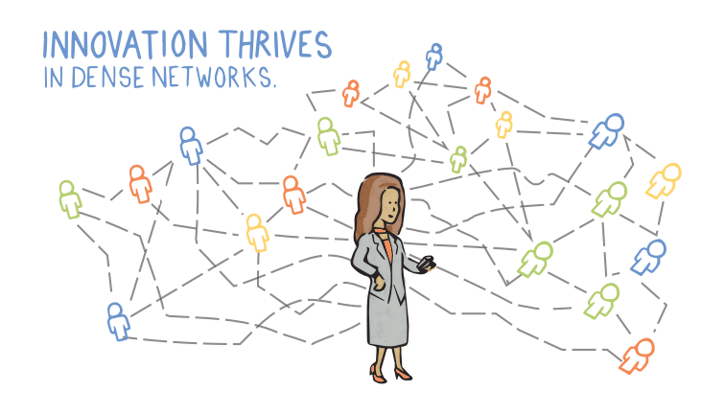
Where do we fit in the Ecosystem?
Notes:
Christian
Franklin County Development Council
Chamber

Slide 9
When do I know it is time to face my finances?
Where do I start? How do I begin?
I need capital but how can I access it?
How can I increase profits?
Am I doing okay?
Why is my bottom line low?
Am I ready to sell my business?
Is this a good price to purchase a business?
Notes:
Carrie

Slide 10
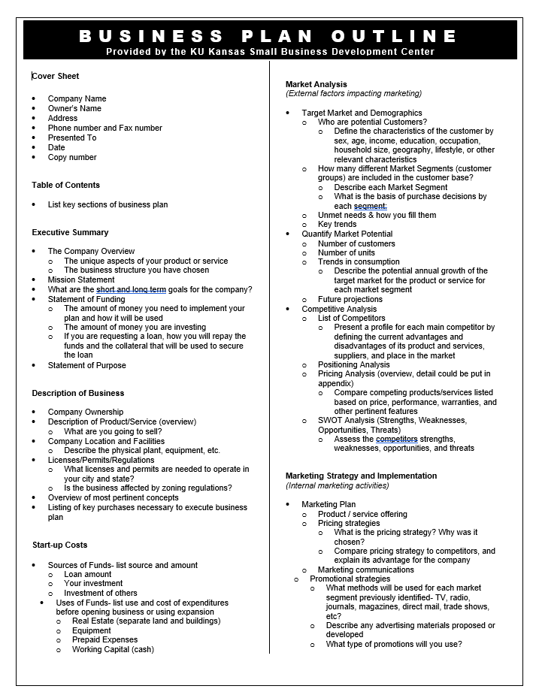
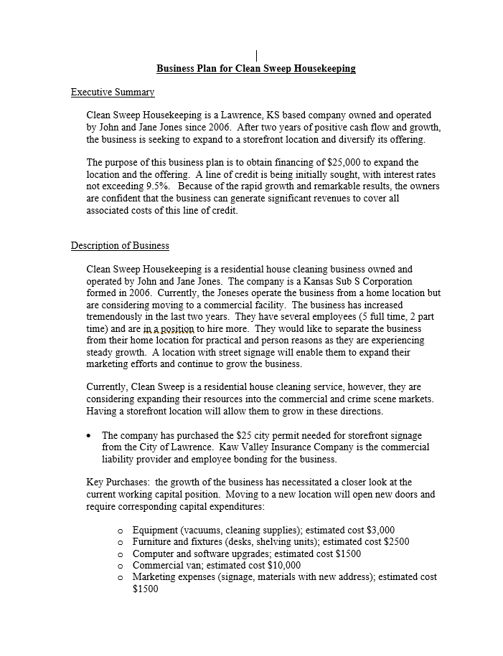
Business Plan Outline and Samples
Notes:
Use plan to organize if you have not created.
Business Plan used for Loans/ grants
Whos on your team
When and how to disperse funds.
you want consistency across your plan this involves the cashflow

Slide 11
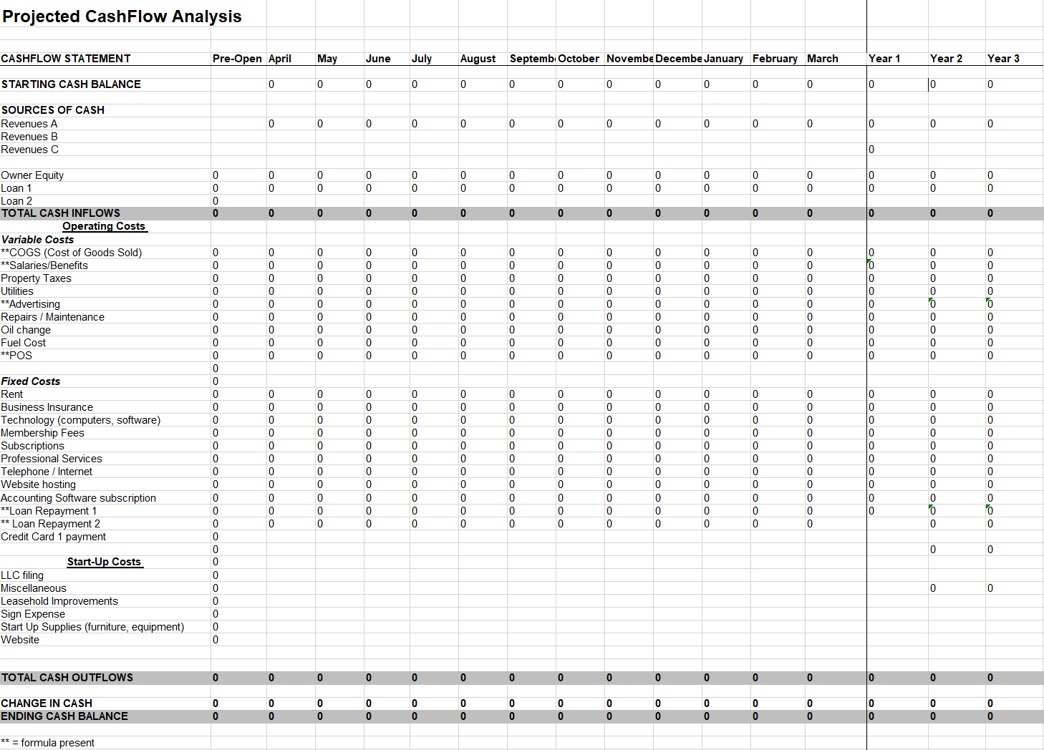
Cash Flow Template

Slide 12
Capital Structure
Bootstrapping
Savings
Retirement
Family
Grant
Federal
State
Commercial
Partners
Controlling parties
Loan
SBA
Network Kansas
Banks/CDFI
Venture Capital
Equity
Debt
Notes:
Operating agreement (operational) ie. partnerships, family
Contracts to define various agreements (family, venture capital)
Capital Structure
Management
Relationship/ Network
Buy/sell

Slide 13
Capital Access Center
Need help accessing capital?
Free and part of the KS SBDC services
Loan eligibility review
Can assist in sourcing a commercial loan
Prior bankers who work for you
Notes:
When prepping for a loan…

Slide 14
5 C’s of Credit
Collateral
Personal assets
Capital
Funding needed
Character
credit score
Capacity
free cashflow to pay back
Conditions
underwriting
Notes:
Capital - funding needed
Collateral - personal assets
Character - Relationship, credit score, business plan, cashflow
Capacity - Payback
Conditions- underwriting
Capital Structure
Management
Relationship/ Network
Buy/sell

Slide 15
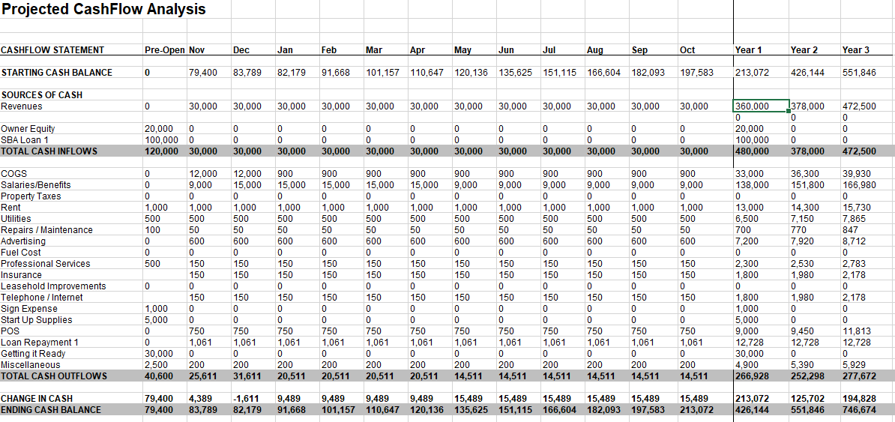
Cash Flow Template
Notes:
Christian

Slide 16
Minimum Viable Product (MVP)
Minimum Viable Product approach
Start Up Costs
Leasehold Improvements
Marketing
Contracts/Legal fees
Bookkeeping
Insurance
Notes:
Carrie

Slide 17
Growth
Storefront
Leasehold improvements
Online Sales
Employee(s)
Employee benefits
Product expansion
Notes:
Carrie

Slide 18
Buy/Sell
Buying approach
Purchase price
Review financials
Projections
Roles of purchaser and seller
Are you being rushed?
Selling approach
Am I ready to sell?
How much do I need?
How much is it worth
What’s my next gig?
(Whats next?)
Notes:
Carrie
Buying
-knowing the price
-getting the financials
-Projecting your own (new costs etc.)
Selling
-Tax returns for the last 3-5 years
-what is your ideal number (meet with financial planner)
-What are your next goals (hobbies, next business, working for business?, etc.)

Slide 19
Relationships and Finances
SBDC advisor
Financial breakdown
Income statement/Balance sheet
Cashflow
Banker
LOC
Bank account
Bookkeeper
Weekly/ monthly meeting
Records management
Accountant/CPA
Quarterly meetings
Reconciliation
Notes:
Carrie

Slide 20
Management and your Finances
Essential Operations Function
Bookkeeping
Knowing your expense categories
Whose responsible
Regular monitoring
Cashflow
Income Taxes
Sales Tax
Registration and Remittance
Exemption Certificates
Notes:
Utilizing Profitcents

Slide 21
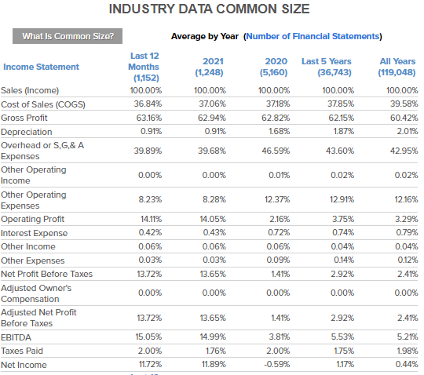
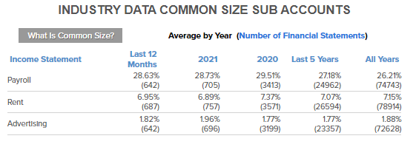
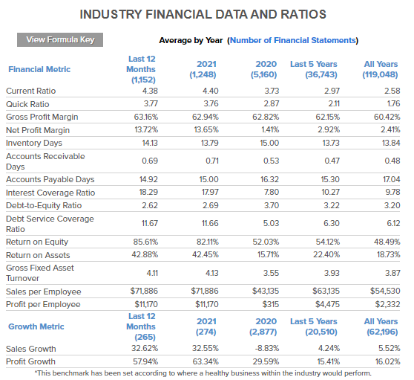
Financial Analysis - Profitcents
Notes:
Christian

Slide 22
Notes:
Carrie

Slide 23
Notes:
Carrie

Slide 33
Our Mission
Our Vision
Help more people!
That was a lot about finances right???
Grow Kansas one small business at a time.
A Few Final Thoughts….
Notes:
Carrie

Slide 34
But wait! There is MORE the SBDC can help with…
Referral Lists
Networking Groups
Training and Educational Opportunities (webinars and in person)
AI and my business
SEO optimization
fincen.gov/boi and does it apply to you?
Notes:
Christian

Slide 35
Beneficial Ownership Information
Financial Crimes Enforcement Network (FINCEN) requires report.
Required of any reporting company LLC or public corporation.
Some exemptions are Sole Proprietorships/General Partnerships/ Trusts (unless Trust needed to file with Secretary of State)
You will need to provide business and personal identifiable information (drivers license or passport)
Free to file
Businesses registered before 2024 have till January 1, 2025. 90 days for new businesses.
Notes:
Christian

Slide 36
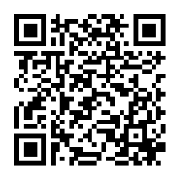
Questions???
KU SBDC
Email:
kristinamease@ku.edu
hopkinsc@ku.edu
carriepoe@ku.edu
Phone: 785-843-8844
Greg Crum​
m. 913-375-5469​
Greg.Crum@DataScribeSolutions.com​
Notes:
Christian

Slide 37
Survey
Tell us your thoughts
Notes:
Christian

