Slide 1
Retention Matters: Strategies for Building a Loyal and Motivated Workforce and
Other Benefit Strategies
Brought to you by:
The Ottawa Chamber of Commerce
and
The KU Small Business Development Center

Slide 2
KU Small Business Development Center
Advising. Consulting. Training. Growing Entrepreneurs

Slide 3
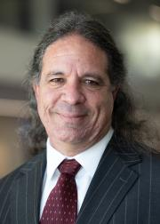
OUR TEAM
Kristina Edwards,
Regional Director
Will Katz, Business Advisor and Interim Director
Carrie Poe,
Business Advisor

Slide 4
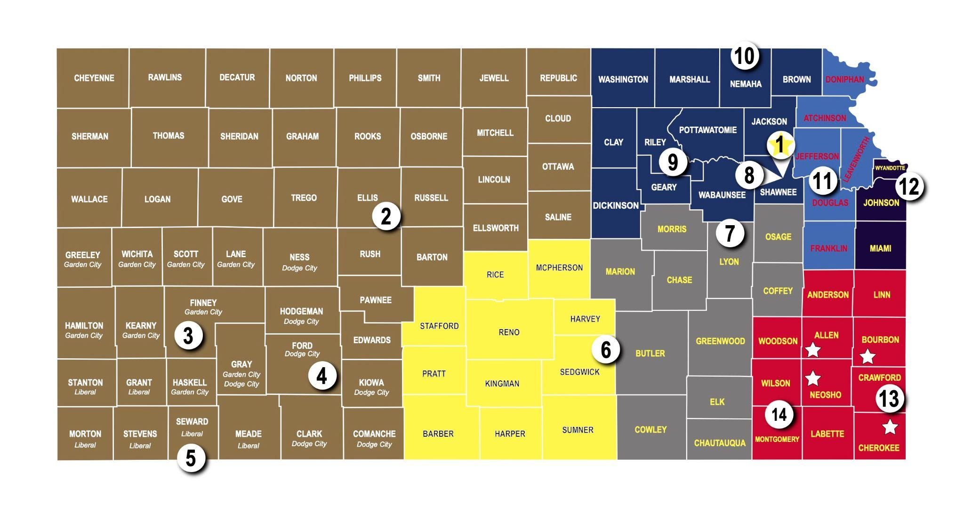
Kansas Small Business Development Centers
KU SBDC covers 6 counties
~ 1,100 Centers across the US
Fun Fact: The KU SBDC office is near downtown Lawrence (not on campus)

Slide 5
Our Mission
Our Vision
Help more people!
Grow Kansas one small business at a time.

Slide 6
What We Do
Individual, one-to-one FREE and confidential advising for start-up AND existing businesses
Focused trainings + content providers
Connection to appropriate resources
Community Partnerships

Slide 7
How we provide services for FREE?

Slide 8
Advising Services
Business Planning
Cash Flow Management
Financial Analysis
Sales and Business Development
Hiring and HR
Market and Consumer Research
Marketing and Social Media
Business Valuation
Notes:
Carrie
We can offer guidance how to create and utilize a business plan.
We can help you understand the process of hiring your first employee.
We can also help you evaluate the price point of purchasing or selling a business as we have a Certified Buisness Valuation Analyst on staff with us par-time.

Slide 9
Advising Services
Where do I start?
How do I take the next steps to grow?
Am I doing okay?
Brainstorm?
Am I ready to sell my business?
What can I do to improve my profits?

Slide 10
Retention Matters: Strategies for Building a Loyal and Motivated Workforce and Other Benefit Strategies

Slide 11
Common employer concerns
Less motivated
Less productive
Not invested
High demands
Pay
Flexibility
Benefits
Cell phone use
Notes:
Carrie
The first one is the business plan. This document can be one of your best business tools to think through every aspect of running your business. Figuring out who the audience is for your business plan will make a difference on what the end product looks like. If it is just for you, it might remain ina bullet pointed format or we can help you prepare one for working with a lender.

Slide 12
Finding the “right” employee
Good job description
set tone of environment
clearly defines job responsibilities
placed where ideal candidates are looking
Interview process
set questions
scoring tool
3. Efficient hiring process
required paperwork
employee handbook, contract, benefits
clear timeline
4. Training
training protocol
review of progress
diverse learning methods, mastery rates

Slide 13
Finding the “right” employee
Hiring Strategies
Define your brand
business reputation
owner’s reputation
Candidates are Customers
respect time
hospitality
Utilize Social Media
Followers are familiar, may be ideal candidates

Slide 14
Finding the “right” employee
Applicant tracking method
no time, software options BreezyHR, Zoho Recruit, Rippling
Job Posting
reflect company personality
focus on soft and practical skills
Local networking and organizations
Utilize Niche Job Boards
professional organizations in industry, Dice (tech), Dribbble (creatives), LinkedIn

Slide 15
Employee Retention Strategies
Why are employees leaving?
Inadequate Pay
Work Life Balance
Dissatisfied
No skill development
Limited career advancement
Work environment
The Great Resignation
Source: Forbes Advisor article

Slide 16
Employee Retention Strategies
Strategies to consider
Competitive Base Pay
Cashflow
ProfitCents
Work from Home or Hybrid
90% increase by 2025 since COVID
report happier, more productive - per UpWork
Flexible Scheduling/Compressed Work week
Encourage Work Life Balance
work email, cell phone
Personal day/hours
Source: Forbes Advisor article
Notes:
A report by the Brandon Hall Group found companies that prioritize recognizing their employees multiple times per month are 41% more likely to see increased employee retention and 34% more likely to see increased employee engagement.

Slide 17
Employee Retention Strategies
Strategies to consider
Recognize and Reward Employees
social recognition
monetary recognition
perks (cell phone, travel, local business discounts, meal discount)
Hire for Business Culture Fit and Value Alignment
higher energy, more productive
higher job sastisfaction
Source: Forbes Advisor article
Notes:
A report by the Brandon Hall Group found companies that prioritize recognizing their employees multiple times per month are 41% more likely to see increased employee retention and 34% more likely to see increased employee engagement.

Slide 18
Employee Retention Strategies
Strategies to consider
Employee survey
anonymous?
must acknowledge and implement some feedback
Recreate/share employee expectations
Create time for check ins
Employee gatherings/outings
social connection
supportive
Source: Forbes Advisor article
Notes:
A report by the Brandon Hall Group found companies that prioritize recognizing their employees multiple times per month are 41% more likely to see increased employee retention and 34% more likely to see increased employee engagement.

Slide 19
Employee Exit Interview
Questions to consider
1. Reasons for Leaving
What prompted you to start looking for a new job?
What is the primary reason you are leaving the company?
2. Job Satisfaction
What did you like most about your job?
Were your job responsibilities what you expected when you were hired?
Did you feel your skills and abilities were fully utilized in your role?

Slide 20
Employee Exit Interview
Questions to consider
3. Work Environment and Culture
How would you describe the company culture?
Did you feel supported by your manager and team?
Were there any issues with work-life balance?
How do you think the company can improve its work environment?
4. Career Development
Did you feel you had opportunities for career growth and advancement here?
Were there sufficient opportunities for training and professional development?

Slide 21
Employee Exit Interview
Questions to consider
5. Compensation and Benefits
Do you believe your pay was fair compared to similar roles at other companies?
Were there any benefits you wish the company offered?
6. Management and Leadership
Did you feel management communicated effectively with employees?
Were there any issues with how management handled employee concerns?
7. Company Policies and Practices
Were company policies clear and easy to follow?
Were there any company policies or practices that you disagreed with?

Slide 22
Employee Exit Interview
Questions to consider
8. Suggestions for Improvement
What changes would you suggest to make this a better place to work?
What advice would you give to your replacement?
9. Future Considerations
Would you consider returning to the company in the future?
Would you recommend this company as a good place to work to others?

Slide 23
And More…
Employee Handbook
Training Tools
Neurodiversity inclusion
Listening Skills and Reflection
Performance reviews
Management Education and Training

Slide 24
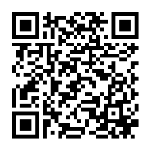
Contact Us!
Email:
kristinamease@ku.edu
willkatz@ku.edu
carriepoe@ku.edu
Phone:
785-843-8844
Address:
718 New Hampshire
Lawrence, Kansas
Website:
https://business.ku.edu/research-and-faculty/centers/ku-sbdc

