Slide 1
Fire Safety for Businesses
Spanish Fork Fire & EMS

Slide 2
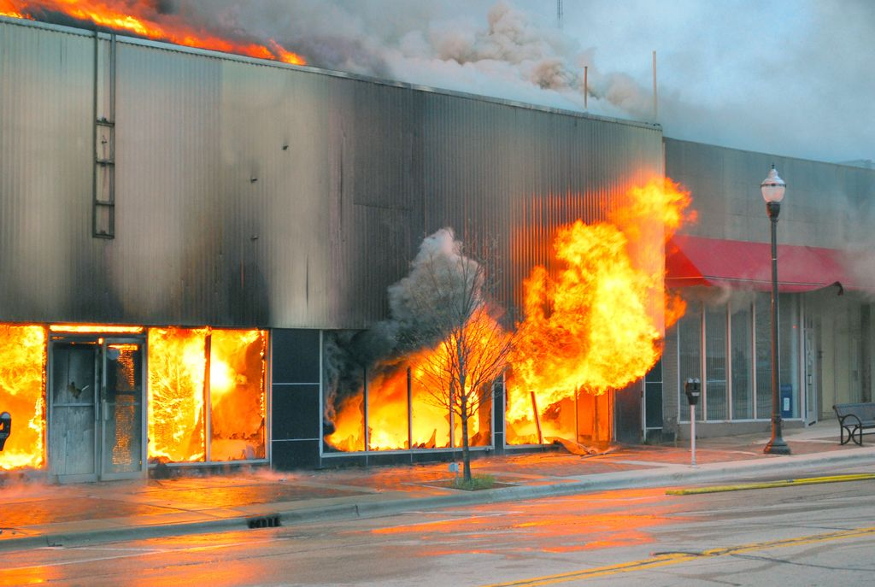
Why we do fire inspections in businesses

Slide 3
Main items we look for when doing an inspection
Is the address visible on the building?
Are fire hydrants visible with 3ft of clearance around them?
Is there adequate fire department access?
Does this building have a fire alarm or fire sprinkler system? Do they have current inspection tags?
Do the exit signs and emergency lights work properly?
Are fire extinguishers visible with current inspection tags or recently purchased?
Are extension cords being used for permanent wiring?
Are surge protectors being plugged into surge protectors?
Are fire sprinkler heads blocked by storage?
Make sure that the electrical panel is clear and labeled correctly?

Slide 4
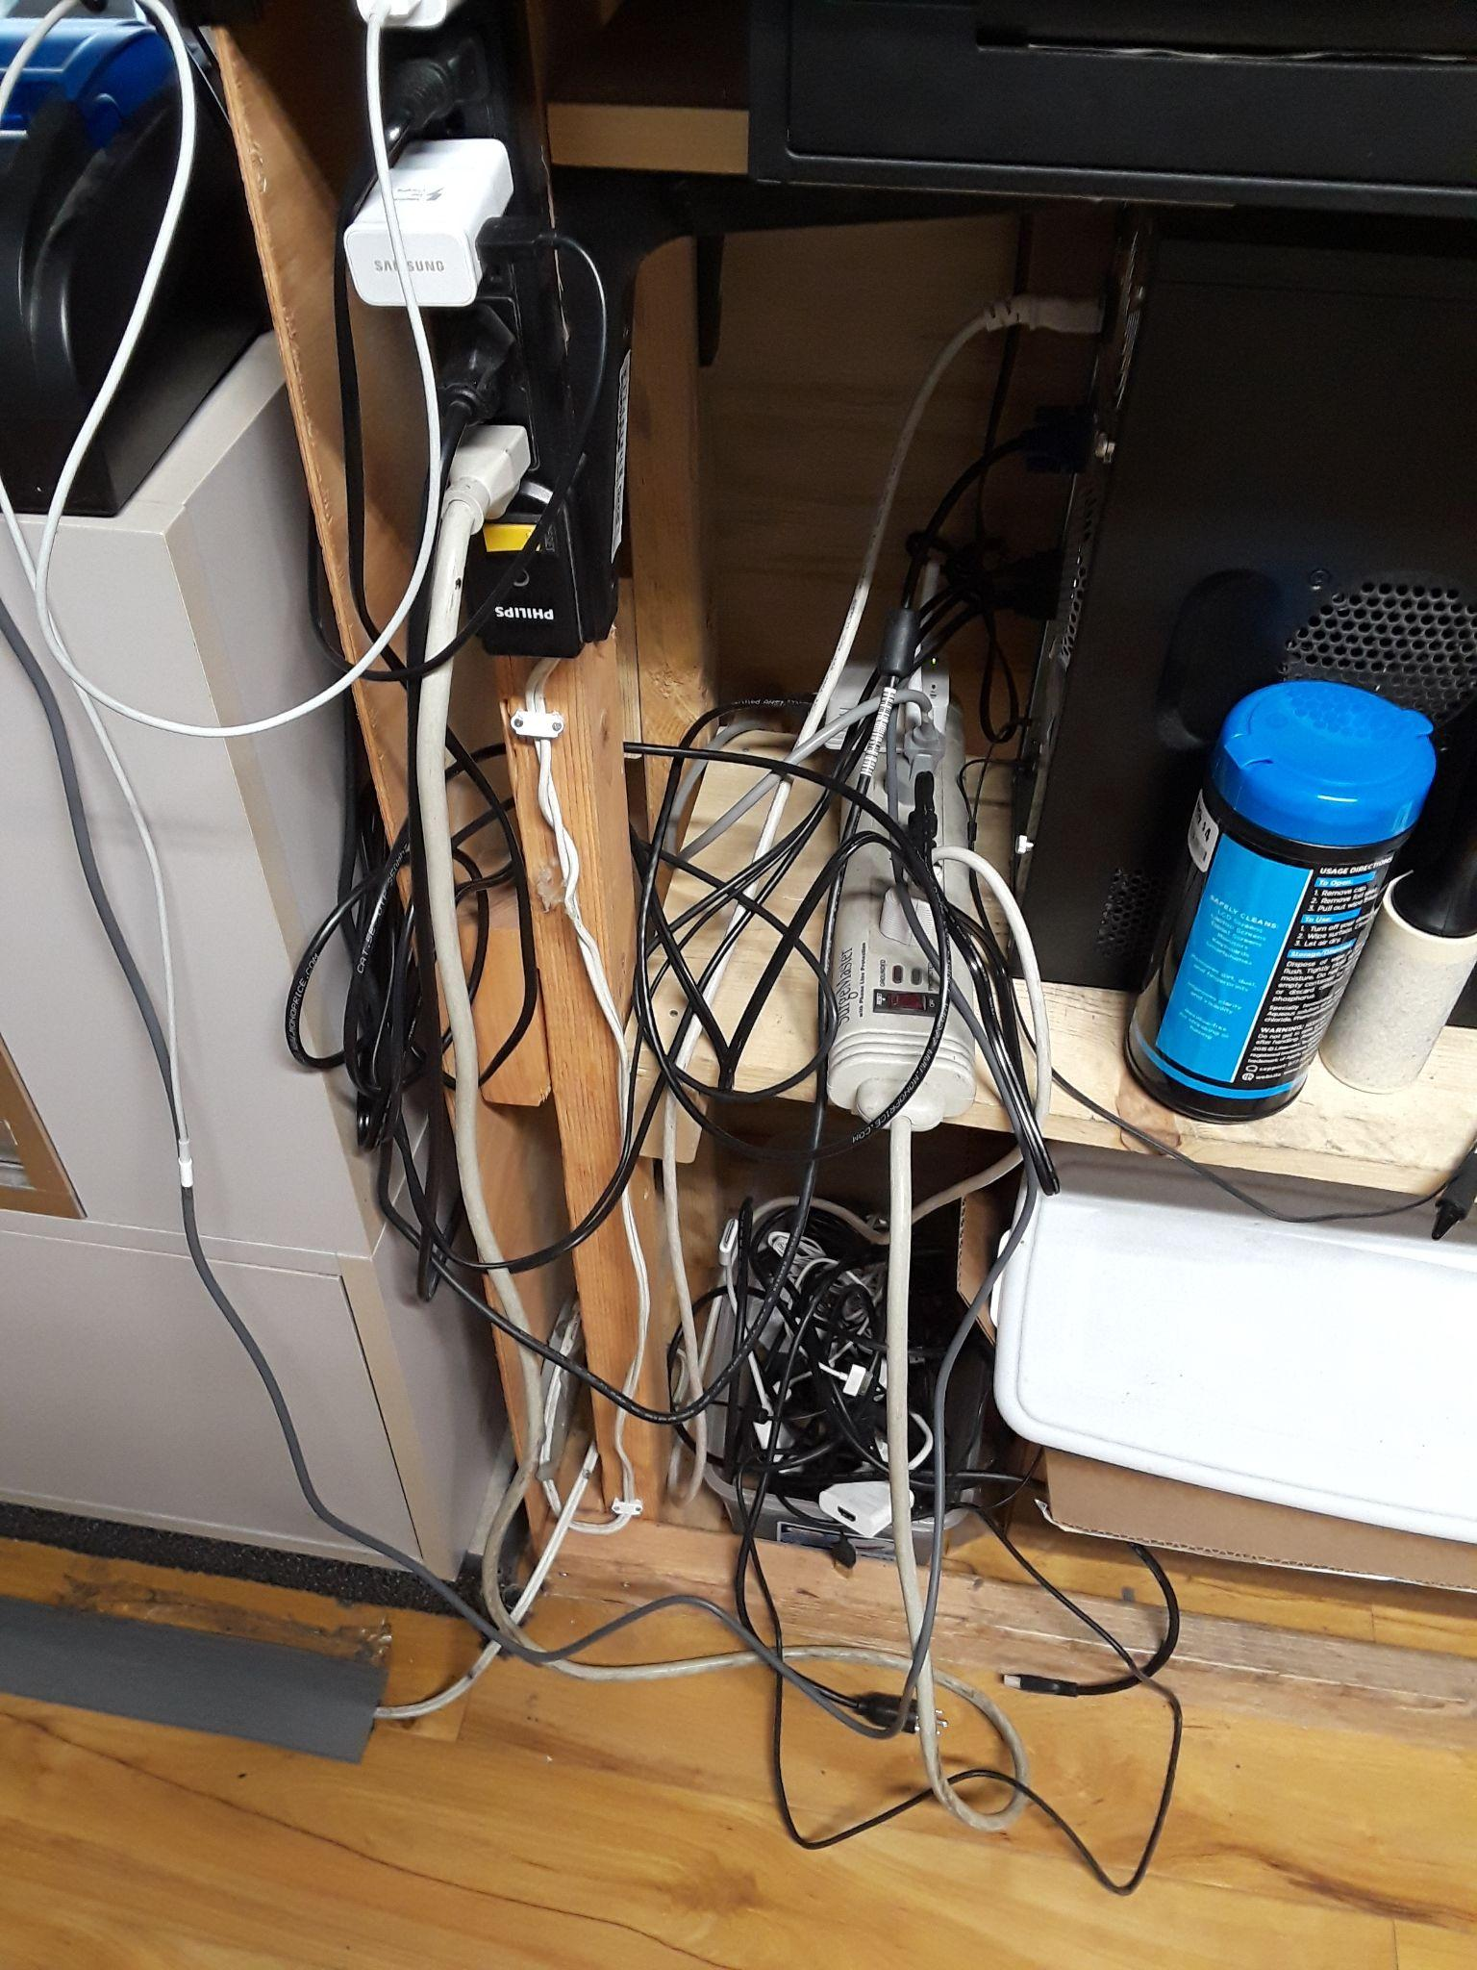
Does this look safe?

Slide 5
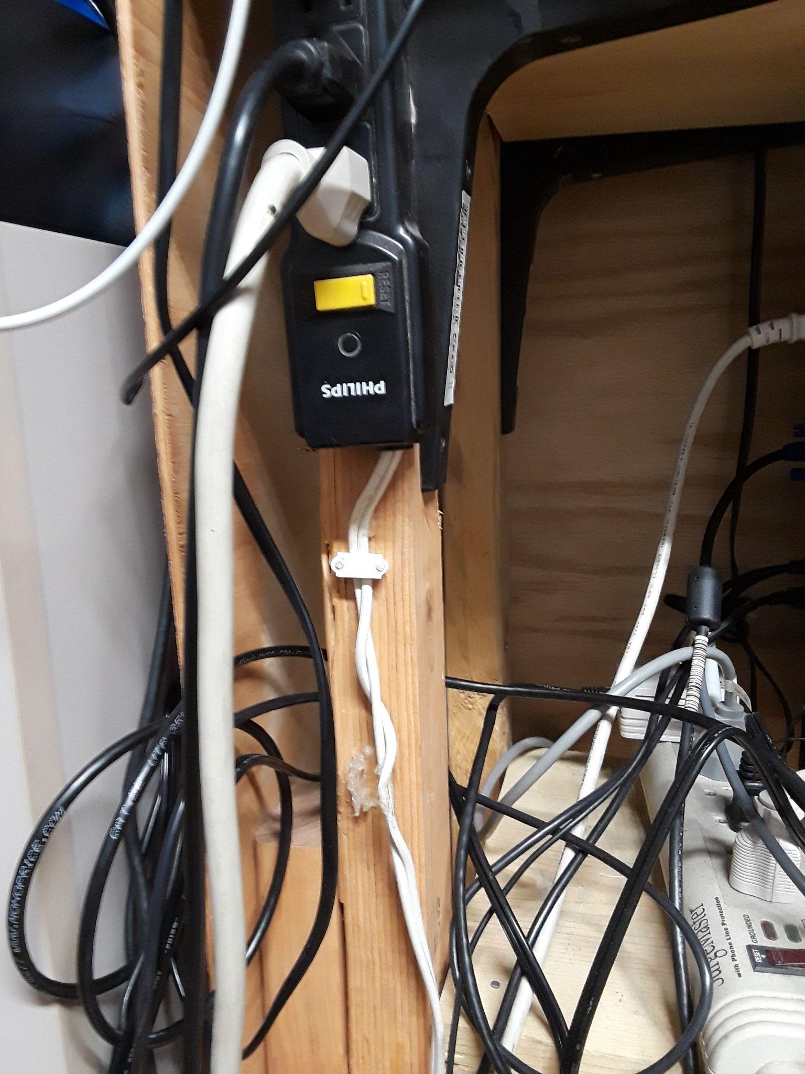
Look close at the white cord
They changed the original power cord with a cheap extension cord wire.
Do you have anything like this in your store or office?

Slide 7
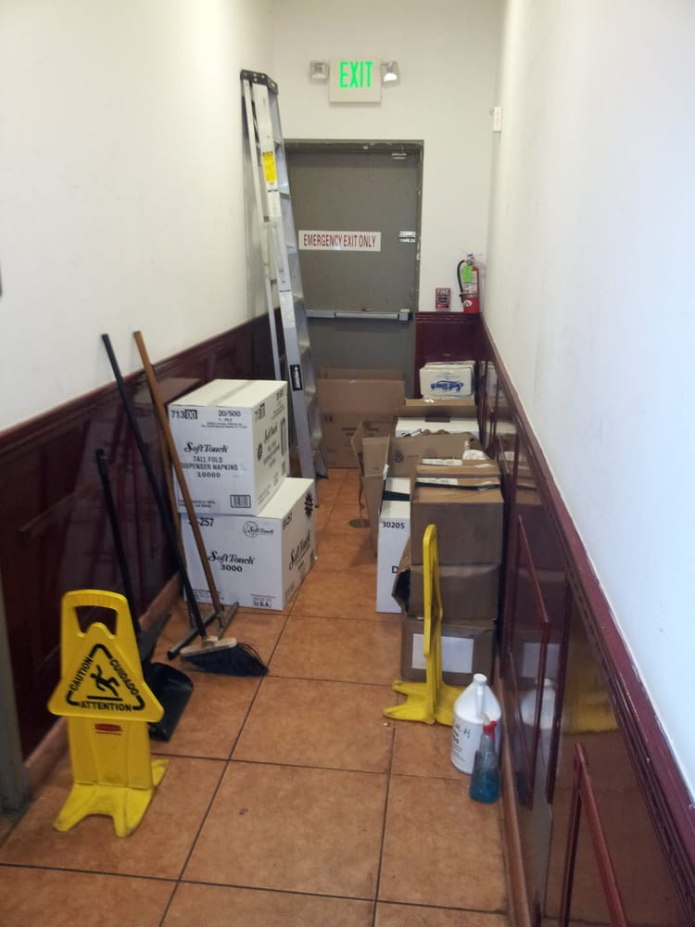
Would you be able to get out quickly?

Slide 8
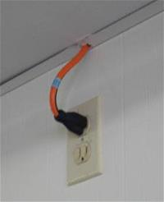
Where does this go?

Slide 9
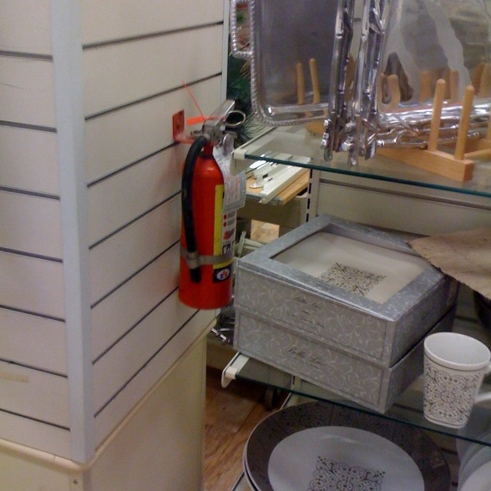
Would you be able to find this?

Slide 10
For questions about the fire code or to schedule a fire inspection contact.
Spanish Fork Fire Marshal Jason Turner
801-804-4755

