Slide 1
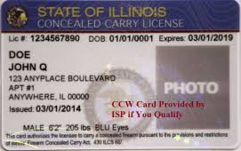
Illinois Concealed Carry 3 Hour Renewal Course Range Qualifications Are Now Available By Appointment Then Attend Any Renewal Class Date Call For Details
618-629-3422

