Slide 1
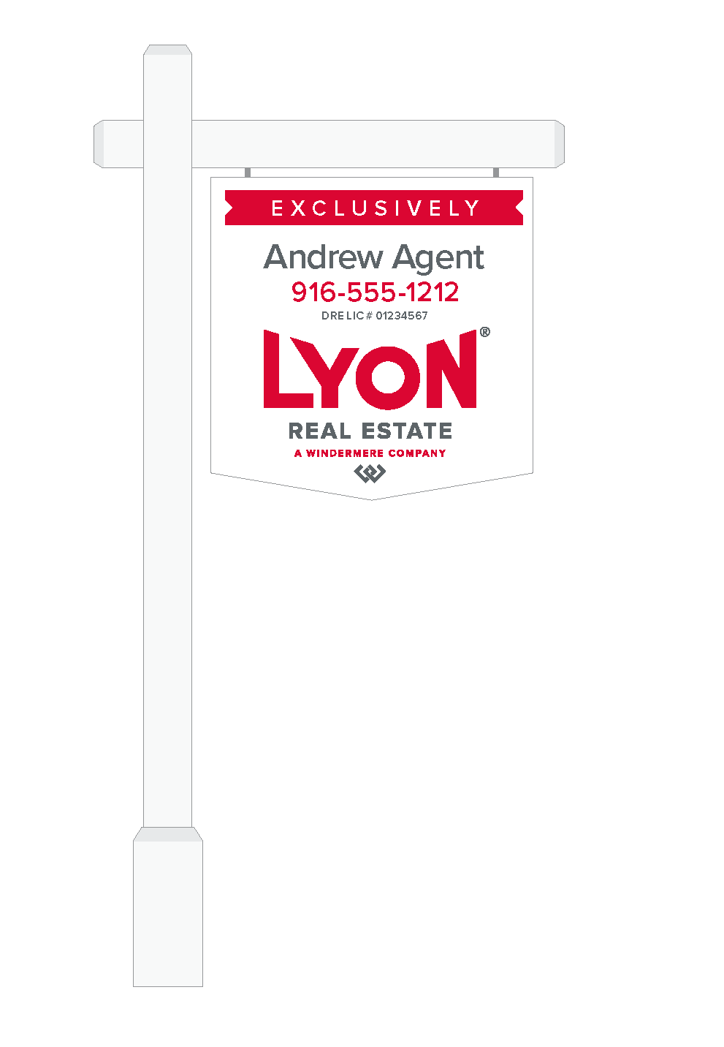
Using a Lyon Agent to Sell Your Home
AS YOUR LYON AGENT:
I know the market and will help you set the right price.
I also know what buyers are looking for and the ﬁnancial incentives that will encourage them to buy.
I am a member of the Multiple Listing Service (MLS), which enables me to provide detailed information about your home to the thousands of other agents assisting buyers.
In addition to the MLS, I interact with other agents on a daily basis. We trade information about new properties and match eager buyers with the right homes.
I have access to several advertising opportunities—both in print and online—that will raise interest in your home.
I will utilize the Lyon Real Estate tools available to me in order to attract the maximum number of buyers to your home.
Lyon’s global referral system provides me access to the large number of people who relocate each year, increasing the pool of qualiﬁed buyers for your home.
I can quickly separate the qualiﬁed buyers from the rest of the pack. This saves you time, because your home is only being shown to serious buyers.
Your home may be your single biggest investment and one of the largest financial transactions you’ll ever make. So when you sell, you want to get the best price and the most favorable terms, in the shortest amount of time. There are many marketing options, legalities, and details that go into the sale. The role of your agent is to represent every aspect of the transaction, from the time you set the price to the final closing.
© 2020 LYON REAL ESTATE
Julie Reardon
916-799-0246
Jreardon@golyon.com

Slide 2
Agent Name
Lyon Real Estate
CalBRE#01925466
cell: 916-799-0246
Jreardon@golyon.com
Jreardon.golyon.com
PLACE YOUR BIOGRAPHY HERE
© 2020 LYON REAL ESTATE

Slide 3
Preparing Your Home for Sale
EXTERIOR:
Remove peeling and chipped paint; replace with a fresh coat.
Fix loose trim and fencing.
Clear gutters and downspouts.
Make sure there is good exterior lighting and all walkway lights and front-door lanterns work.
Clean and repair the roof as needed.
Clear garage of clutter and tidy shelves.
Inspect chimney for cracks and damage.
YARD:
Mow and trim grass; re-seed and fertilize where necessary.
Prune all overgrown trees and shrubs.
Weed flower beds. Remove or replace dead or diseased plants, shrubs and trees.
Clean grease and oil stains from driveway.
DECKS/PATIOS:
Paint or stain worn areas on wood decks.
Remove grass growing in concrete cracks; sweep oﬀ debris from shrubs and trees.
Clean all deck rails and make sure they’re secure; replace missing slats or posts.
Clean outdoor furniture.
FRONT DOOR:
Polish or replace the door hardware so it shines.
Add a fresh coat of paint to get rid of nicks.
Make sure the doorbell operates properly and there are no squeaks when the door opens and closes.
WINDOWS:
Clean all windows inside and out.
If needed, add a fresh coat of paint to the window trims and sills.
Make sure all windows open and close easily.
Replace cracked window panes and those with broken seals.
Make sure window screens are clean and secure; replace any screens with holes or tears.
ENTRY:
Clean entryway ﬂoors and area rugs.
Downsize clutter in the entry and entry closet to give the appearance of spaciousness.
Double-check entry lighting to make sure it works.
THROUGHOUT:
Clean all floors, carpets, walls and trim.
Replace burned-out light bulbs.
Empty trash.
Remove family photos, valuables, and prescription drugs.
KITCHEN:
Make sure countertops, grout, and sinks are clean and stain-free. Replace grout as needed.
Fix dripping faucets.
Organize pantry and cupboards so they appear clean, neat and spacious.
Make sure the refrigerator and freezer are defrosted and free of odors.
Clean the oven and cook-top thoroughly.
Set the table.
© 2020 LYON REAL ESTATE

Slide 4
LIVING/FAMILY/DINING ROOMS:
Give rooms a fresh coat of paint as needed.
Repair cracks and holes in ceiling and walls.
Make sure all wallpaper is secure.
Repaint any woodwork that is worn or chipped.
Clean or replace draperies and blinds; open them to maximize light.
Make sure draperies and blinds open and close.
Steam-clean carpets. Clean rugs and wood ﬂooring, and remove any stains or odors.
Position the furniture to showcase the size and space of the room.
Remove and replace any attached items, such as chandeliers and draperies, that you wish to move with you.
Put away toys and hobby supplies; remove extra magazines and books from tables.
BATHROOMS:
Make sure sinks, tubs, showers and countertops are clean and free of stains.
Repair any leaky faucets.
Remove grout and soap stains from tile.
Replace any missing or cracked tiles or grout.
Make sure all joints are caulked.
Make sure all ﬁxtures, including heat lamps and exhaust fans, are operating.
Install a new shower curtain and buy matching towels.
Store all supplies, such as toilet paper, shampoo bottles and cleansers, out of sight.
BEDROOMS:
Repair cracks in ceiling and walls.
Apply a fresh coat of paint if necessary.
Make sure wallpaper is secure.
Clean draperies and blinds; open them to maximize light.
Put away toys, clothes, and clutter.
Neatly make up the beds.
BASEMENT:
Check for water penetration or dampness; call for professional repairs if necessary.
Get rid of musty odors.
Clean furnace, hot water heater, and drains.
Make sure light ﬁxtures work.
Arrange storage area in a neat and organized manner.
Make sure stairway handrail is secure.
TIDY EXTRAS:
Use air fresheners or bake treats to make the house smell good.
Plant ﬂowers to brighten a walkway and enrich the entry.
Remove any indoor houseplants that are brown or losing their leaves.
Remove all “ﬁxer” cars, campers and boats from the property.
Discard the clutter of magazines on the coﬀee and end tables.
Tidy and declutter all closets.
Hide or get rid of worn-out throw pillows.
Store pet supplies.
At night, turn on the porch light and outdoor lighting. Buyers often drive by homes they are considering at various times of day.
© 2020 LYON REAL ESTATE

Slide 5
Lyon Home Improvement Concierge
Renovate now, pay when you sell with no upfront costs.
The Lyon Home Improvement Concierge helps you make significantly more money
on the sale of your home when you complete improvements and pay at the close of
the transaction. Whether it’s a coat of fresh paint, new flooring, or a kitchen
renovation, all costs of the project are deferred until the sale of your home.
Features of the program:
Your Project Manager will oversee the entire renovation, so you won’t need to make design choices or lift a finger.
100% of all project costs are deferred until the home sells with no upfront deposits, loans, progress payments, fees, interest charges, or credit checks.
Easy-to-use app gives agents and homeowners full visibility into their project 24/7, including photos, timelines, and messages.
We handle all the details from proposal to punch list, quickly transforming homes into the move-in condition buyers want and maximizing your value.
Agents/homeowners can select from a wide variety of designer-curated style & ﬁnish options
No minimums or maximums
Project budget can equal up to 80% of sellers’ net equity*
I will be by your side throughout the entire process.
* Net equity - list price after renovations, less money owed
© 2020 LYON REAL ESTATE

Slide 6
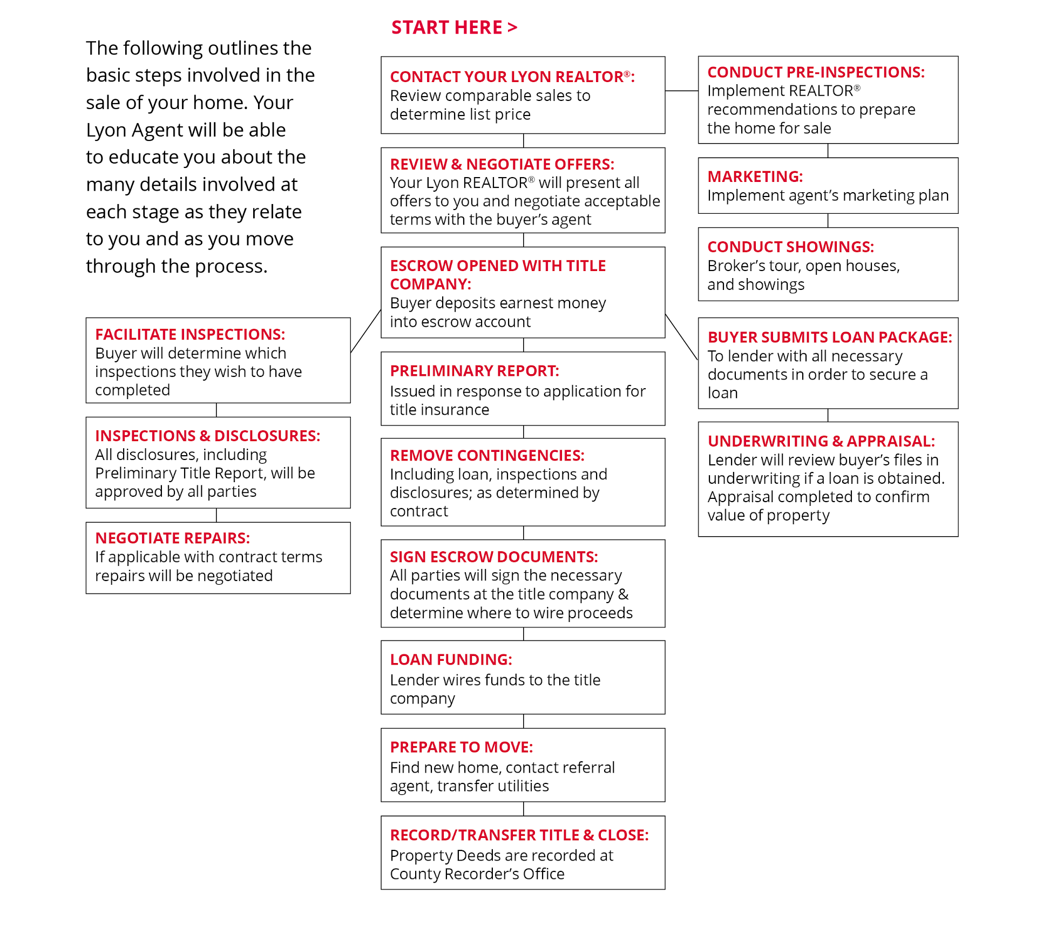
The Selling Process
© 2020 LYON REAL ESTATE

Slide 7
Home Inspections
Once a buyer has decided to make an oﬀer on your home, it will usually be contingent upon a professional inspection of the entire property—including improvements. The home inspector looks beyond the cosmetics to make sure that the home’s general systems operate properly. The inspector will also look for large repairs that are needed and report on the condition of the home.
The standard home inspector’s report will review the conditions of the home’s heating and cooling systems; interior plumbing and electrical systems; the roof, attic and visible insulation; walls, ceilings, ﬂoors, windows and doors; foundation, basement and visible structure. The inspector will also look for cracks in cement walls, water stains that indicate leakage, and any indication of wood rot.
A home inspection also points out the positive aspects of a home, as well as the maintenance that will be necessary to keep it in good shape.
As the seller, you can also elect to hire an inspector to evaluate your home prior to putting it on the market. Many times an inspector can point out major or minor issues with your home that you may be unaware of and that may affect its value.
As your Lyon agent, I’m familiar with home-inspection services and can provide you with a list of names from which to choose. Another good way to ﬁnd a home inspector is to ask a friend, or perhaps a business acquaintance, who has had a home inspection and can recommend a home inspector they were satisﬁed with.
Remember, no home is perfect. If major problems are found, I will help you negotiate through the process.
© 2020 LYON REAL ESTATE

Slide 8
Moving Tips
The process of moving is long and complex. Being organized, knowing what needs to be done, and tackling tasks efficiently can make your move significantly less stressful. Here’s a checklist to keep you on task and help make your move successful.
SIX TO EIGHT WEEKS BEFORE:
Use up things that may be diﬃcult to move, such as frozen food.
Get estimates from professional movers or from truck rental companies if you are moving yourself.
Once you’ve selected a mover, discuss insurance, packing, loading and delivery, and the claims procedure.
Sort through your possessions. Decide what you want to keep, what you want to sell and what you wish to donate to charity.
Record serial numbers on electronic equipment, take photos (or video) of all your belongings and create an inventory list.
Change your utilities, including phone, power and water, from your old address to your new address.
Obtain a change of address packet from the post oﬃce and send to creditors, magazine subscription offices and catalog vendors.
Discuss tax-deductible moving expenses with your accountant and begin keeping accurate records.
TWO TO FOUR WEEKS BEFORE:
If you’re moving to a new community, contact the Chamber of Commerce and school district and request information about services.
Make reservations with airlines, hotels and car rental agencies, if needed.
If you are moving yourself, use your inventory list to determine how many boxes you will need.
Begin packing nonessential items.
Arrange for storage, if needed.
If you have items you don’t want to pack and move, hold a yard sale.
Get car license, registration and insurance in order.
Transfer your bank accounts to new branch locations. Cancel any direct deposit or automatic payments from your accounts if changing banks.
Make special arrangements to move pets, and consult your veterinarian about ways to make travel comfortable for them.
Have your car checked and serviced for the trip.
Collect items from safe-deposit box if changing banks.
TWO TO THREE DAYS PRIOR:
Have movers pack your belongings.
Label each box with the contents and the room where you want it to be delivered.
Arrange to have payment ready for the moving company.
Set aside legal documents and valuables that you do not want packed.
Pack clothing and toiletries, along with extra clothes in case the moving company is delayed.
Give your travel itinerary to a close friend or relative so they can reach you as needed.
© 2020 LYON REAL ESTATE

Slide 9
Moving Day Tips
Pack a “ﬁrst day” box with items you will need right away.
MOVING DAY: OLD HOME
Pick up the truck as early as possible if you are moving yourself.
Make a list of every item and box loaded on the truck.
Let the mover know how to reach you.
Double-check closets, cupboards, attic, basement and garage for any left-behind items.
MOVING DAY: NEW HOME
Be on hand at the new home to answer questions and give instructions to the mover.
Check oﬀ boxes and items as they come oﬀ the truck.
Install new locks.
Conﬁrm that the utilities have been turned on and are ready for use.
Unpack your “ﬁrst day” box (see list for suggested contents).
Unpack children’s toys and ﬁnd a safe place for them to play.
Examine your goods for damage.
MOVING ESSENTIALS:
furniture pads
handtruck or dolly
packing tape
bubble wrap
newspapers or
packing paper
scissors
utility knife
labels
felt-tip markers
cornstarch packing “peanuts”
plenty of boxes
FIRST DAY BOX:
scissors
utility knife
local phone book
coﬀee cups
teakettle
instant coﬀee
or tea, soft drinks
pencil and paper
soap
bath towels
trash bags
shelf liner
paper plates
snacks
toilet paper
children’s toys and books
© 2020 LYON REAL ESTATE

Slide 10
Glossary
ADJUSTABLE-RATE MORTGAGE (ARM) | interest rates on this type of mortgage are periodically adjusted up or down depending on a speciﬁed ﬁnancial index
AMORTIZATION | a method of equalizing the monthly mortgage payments over the life of the loan, even though the proportion of principal to interest changes over time. In the early part of the loan, the principal repayment is very low, while the interest payment is very high. At the end of the loan, the relationship is reversed
ANNUAL PERCENTAGE RATE | the actual ﬁnance charge for a loan, including points and fees, in addition to the stated interest rate
APPRAISAL | an expert opinion of the value or worth of a property
ASSESSED VALUE | the value placed on a property by a municipality for purposes of levying taxes. It may diﬀer widely from appraised or market value
BALLOON PAYMENT | a large principal payment due all at once at the end of some loan terms
CAP | a limit on how much the interest rate can change in an adjustable-rate mortgage
CERTIFICATE OF TITLE | a document, signed by a title examiner, stating that a seller has an insurable title to the property
CLOSING | the deed to a property is legally transferred from seller to buyer, and documents are recorded
CLOSING COSTS | see “settlement”
COMMISSION | a fee (usually a percentage of the total transaction) paid to an agent or broker for services performed
COMPARATIVE MARKET ANALYSIS (CMA) | a survey of the attributes and selling prices of comparable homes on the market or recently sold; used to help determine a correct pricing strategy for a seller’s property
CONTINGENCY | a condition in a contract that must be met for the contract to be binding
CONTRACT | a binding legal agreement between two or more parties that outlines the conditions for the exchange of value (for example: money exchanged for title to property)
DEED | a legal document that formally conveys ownership of a property from seller to buyer
DOWN PAYMENT | a percentage of the purchase price that the buyer must pay in cash and may not borrow from the lender
EQUITY | the value of the property actually owned by the homeowner: purchase price, plus appreciation, plus improvements, less mortgages and liens
ESCROW | a fund or account held by a third-party custodian until conditions of a contract are met
FIXED-RATE MORTGAGE | interest rates on this type of mortgage remain the same over the life of the loan. Compare to “adjustable-rate mortgage”
© 2020 LYON REAL ESTATE

Slide 11
Glossary
FIXTURE | a recognizable entity (such as a kitchen cabinet, drape or light ﬁxture) that is permanently attached to a property and belongs to the property when it is sold
HAZARD INSURANCE | compensates for property damage from speciﬁed hazards such as ﬁre and wind
INTEREST | the cost of borrowing money, usually expressed as a percentage rate
LIEN | a security claim on a property until a debt is satisﬁed
LISTING CONTRACT | an agreement whereby an owner engages a real estate company for a speciﬁed period of time to sell a property, for which, upon the sale, the agent receives a commission
MARKET PRICE | the actual price at which a property sold
MARKET VALUE | the price that is established by present economic conditions, location and general trends
MORTGAGE | security claim by a lender against a property until the debt is paid
MULTIPLE LISTING SERVICE (MLS) | a system that provides to its members detailed information about properties for sale
ORIGINATION FEE | an application fee(s) for processing a proposed mortgage loan
PITI | principal, interest, taxes and insurance, forming the basis for monthly mortgage payments
POINT | one percent of the loan principal. It’s charged in addition to interest and fees
PREPAYMENT PENALTY | a fee paid by a borrower who pays oﬀ the loan before it is due
PRINCIPAL | one of the parties to a contract; or the amount of money borrowed, for which interest is charged
PRORATE | divide or assess proportionately
PURCHASE & SALE AGREEMENT | a contract between buyer and seller that outlines the details of the property transfer; or refer to “Purchase and Sale Agreement” in this guide
SETTLEMENT | all ﬁnancial transactions required to make the contract ﬁnal.
TITLE | a document that indicates ownership of a speciﬁc property
TITLE SEARCH | detailed examination of the entire document history of a property title to make sure there are no legal encumbrances
© 2020 LYON REAL ESTATE

